Slide 1
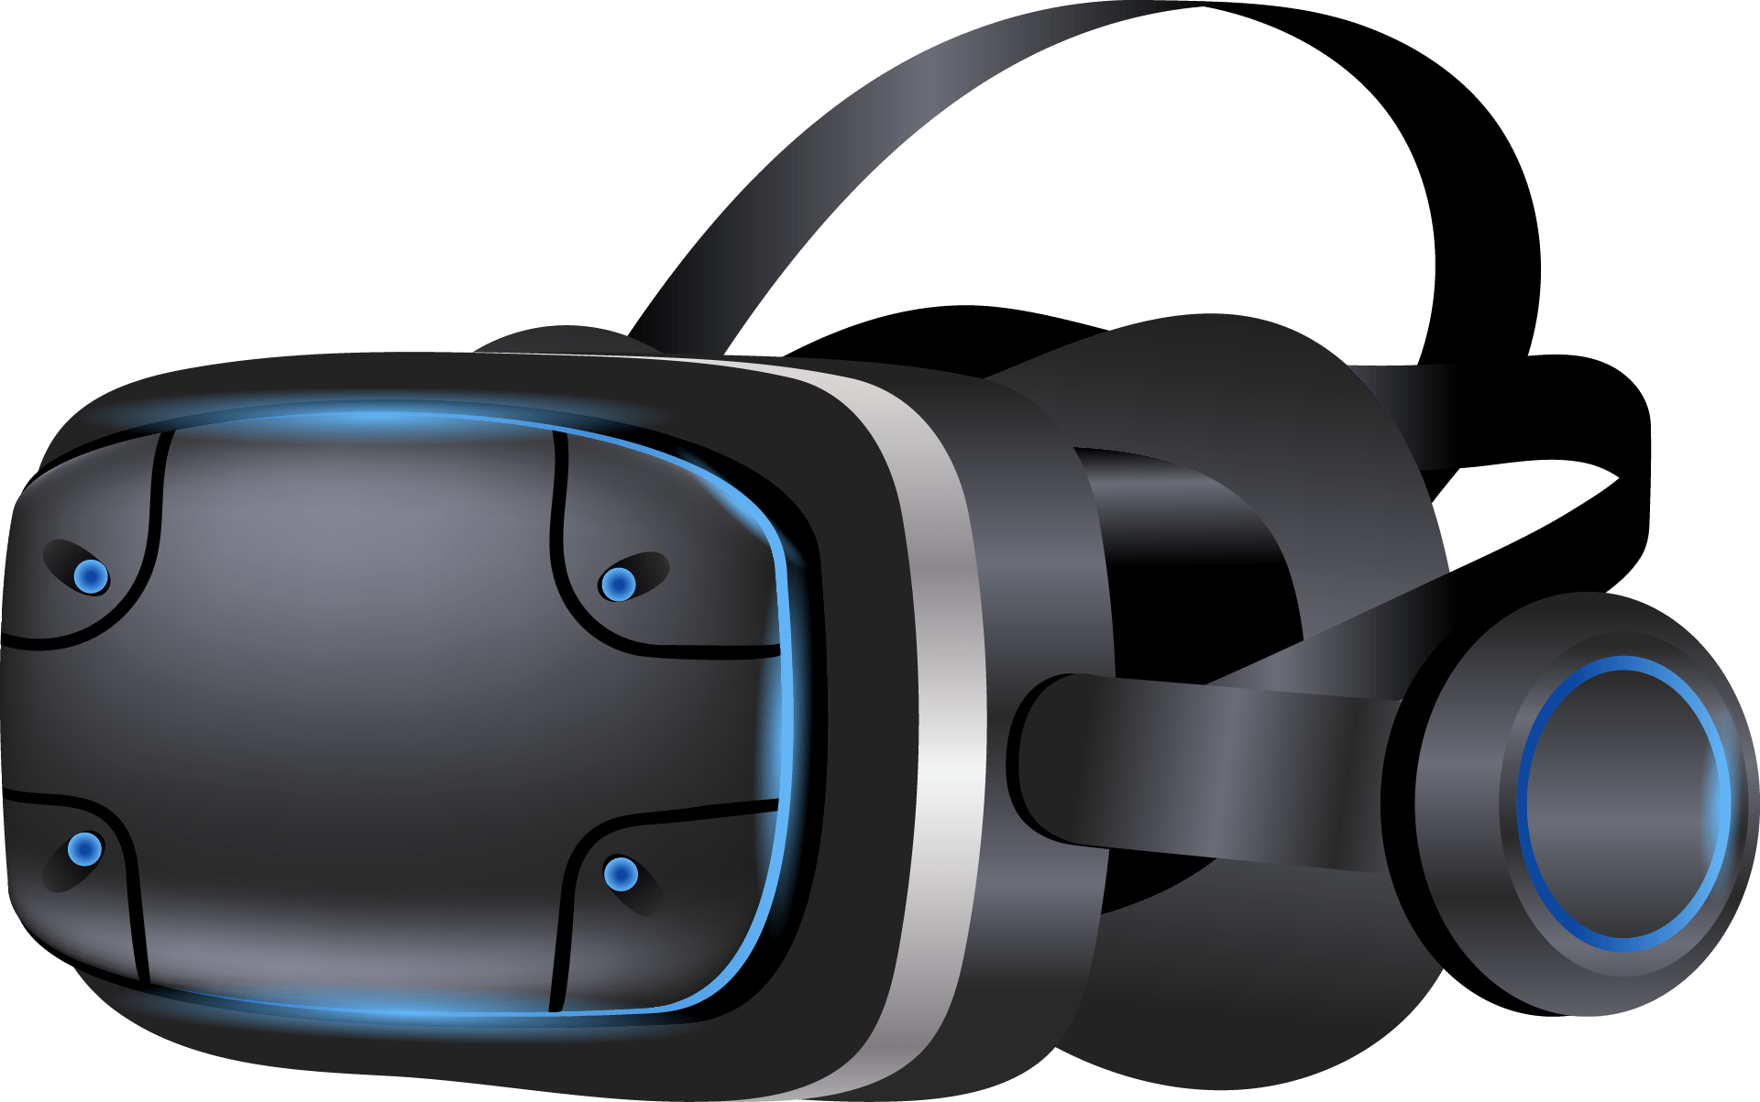
VIRTUAL REALITY
Dr Douar Amel
Bendada Ibrahim
Boulekzazel Tayeb
Ouret Zineddine Ahmed
Dekkar Raid
Adjissa Mohamed
Charaga Monaim
Abdelaziz Soundous
Belkefoul Kaouther
Mahdaoui Nourelhouda
Bensalem Salsabil

Slide 2
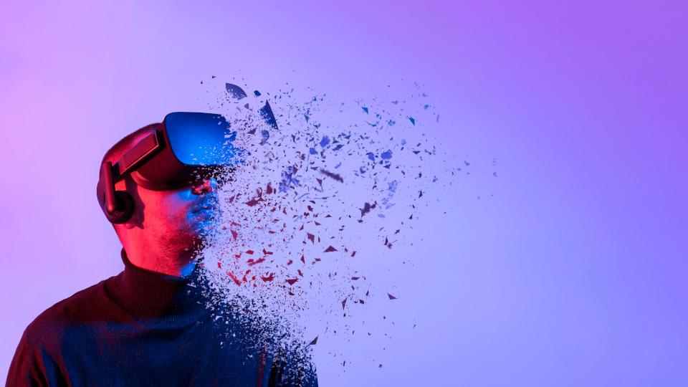
Contents of this presentation
01
Definition
02
History And Evolution
03
Component of Virtual Reality
04
Application of Virtual Reality
05
Advantages And Challenges
06
Future of Virtual Reality

Slide 3

What is VR?
01

Slide 4

Definition
Immersion and interaction are the two key words of virtual reality.
Virtual reality is a scientific and technical field that uses computer science (1) and behavioral interfaces (2) to simulate a virtual world (3) where 3D entities interact in real time with users (4). It provides pseudo-natural immersion (5) through sensorimotor channels.

Slide 5
This definition introduces certain terminology requiring some explanations
1
Creating interactive virtual environments relies on computer science hardware and software to ensure real-time operation of entities based on physical and behavioral laws.
Behavioral interfaces in virtual reality, including sensorial, motor, and sensorimotor interfaces, facilitate interaction by relaying sensory feedback, capturing user actions, and enabling two-way communication, with selection based on the application's needs.
2
Creating an interactive, real-time virtual world involves modeling, digitizing, and processing, with mixed reality blending the virtual and real worlds
3
Real-time interaction happens when users don't perceive latency between their actions and the environment's response, and efforts should minimize disruptions if delays occur.
4
4
Users should experience "pseudo-natural immersion" in the virtual world, as true immersion is impossible due to sensorimotor biases. This sensation varies depending on the application and devices used.
5

Slide 6
02
History and Evolution

Slide 7
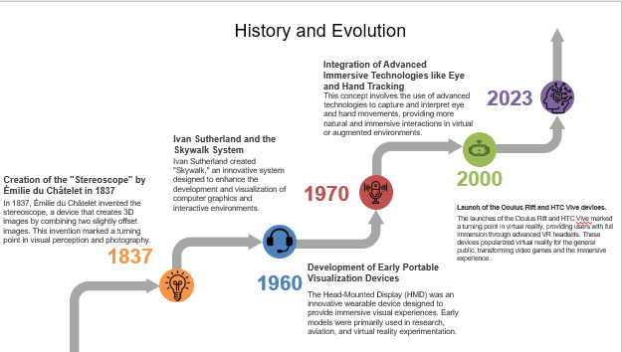

Slide 8

03
Components of VR

Slide 9


The Essential Components of Virtual Reality (VR):
Virtual reality (VR) is an immersive technology that allows users to immerse themselves in simulated, interactive and three-dimensional environments. To create a realistic and engaging VR experience, several hardware and software components play a key role. The following is a detailed presentation of the main elements required for a virtual reality system.

Slide 10
Components of VR
Hardware
Software

Slide 11
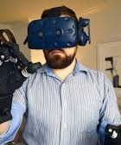
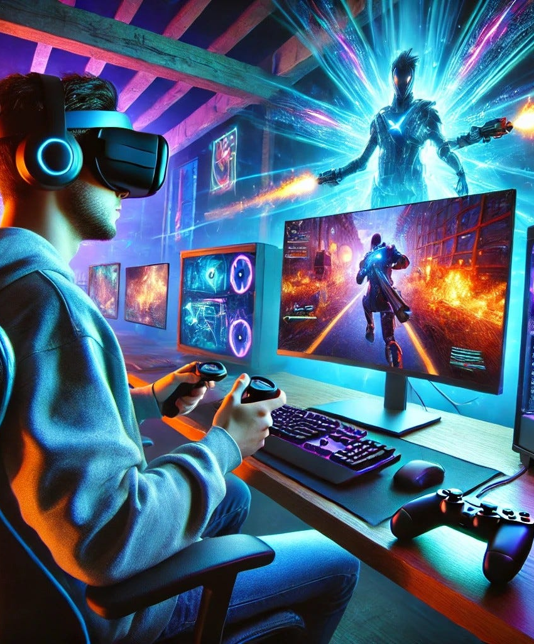
Hardware Components
Haptic Feedback Devices
Computers or Game Consoles
VR experiences require a lot of computing power, especially for headsets connected to PCs or consoles
Minimum specifications for a VR Ready PC: • Processor: Intel i5 or Ryzen 5 (or higher). • Graphics card: equivalent AMD. • RAM: 8 GB or more. Examples of VR-compatible consoles: • PlayStation 5 with the PlayStation VR2.
They allow you to experience physical sensations in the virtual world.
Examples: • Haptic gloves: Simulate touch and textures • Haptic jackets: Vibrations or pressures on the body • VR Shoes: Simulate the sensations of walking.

Slide 12
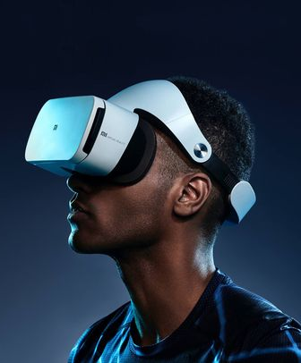
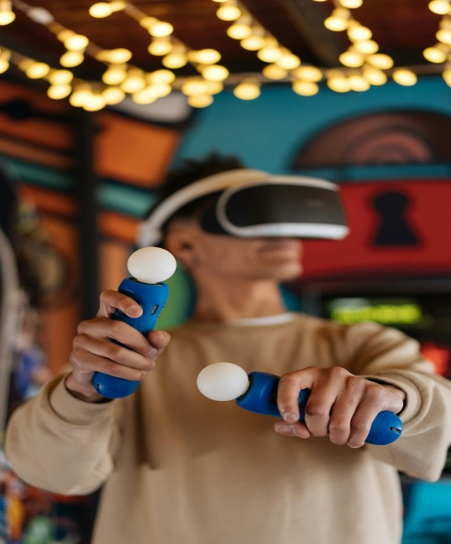
Hardware Components
VR Headsets
Motion controllers
These devices allow the user to interact with the virtual environment. They detect hand movements and translate these gestures into the virtual world.
features: • Motion sensors • Buttons for navigation and interaction. • Haptic feedback for realistic tactile sensations.
The headset is the primary entry point into virtual reality. It covers the user’s eyes and incorporates high-definition displays, sensors and sometimes speakers.

Slide 13
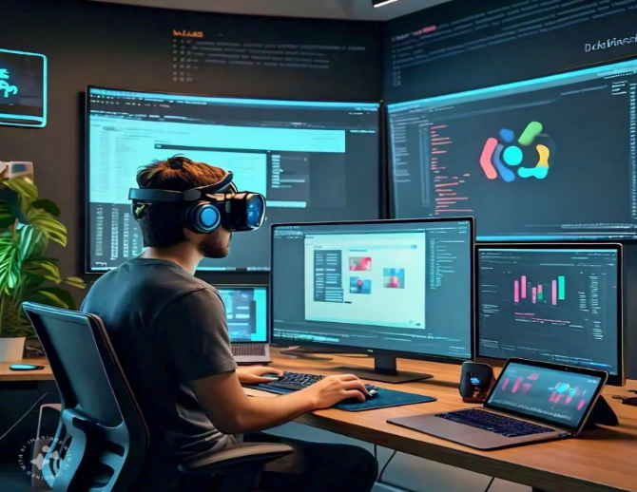
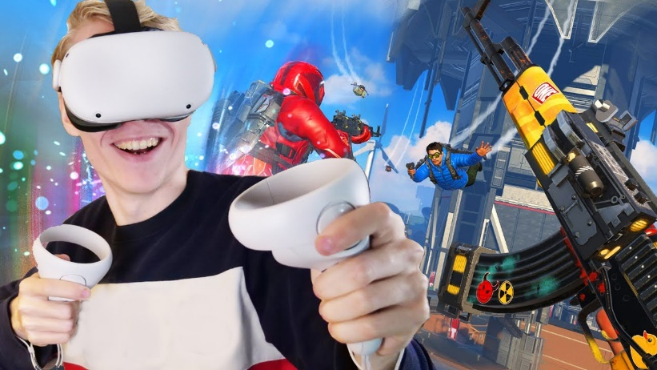
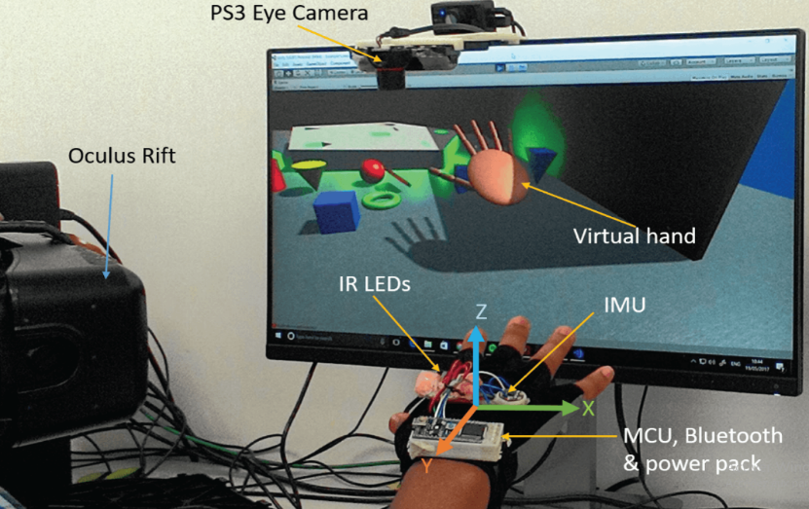
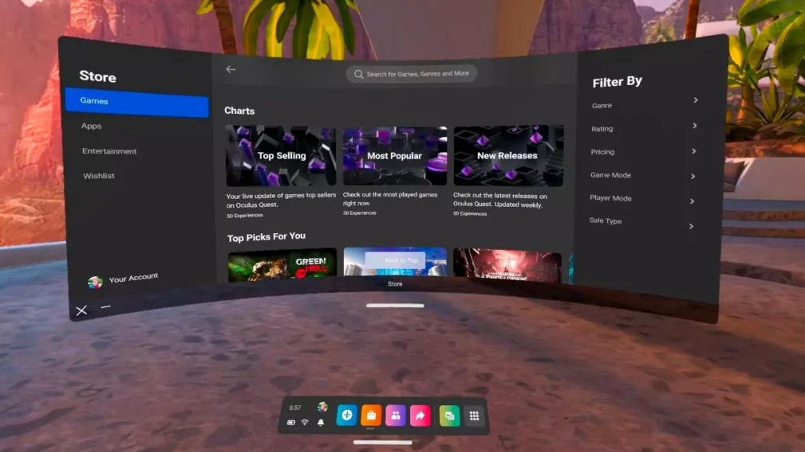
Software Components
VR Development Engines
VR Apps and Games
VR Operating System
VR Tracking Systems

Slide 14


VR Development Engines
VR development engines are essential for creating immersive virtual experiences. These engines, like Unity and Unreal Engine, provide the tools and platforms needed to design and deploy interactive VR apps and games. They enable developers to craft engaging worlds, simulate interactions, and support various VR hardware for a seamless experience.

Slide 15
VR is not just about hardware; the software, especially apps and games, plays a crucial role in delivering a compelling experience.
VR content is wide-ranging, from interactive entertainment to educational and professional simulations.
VR apps and games push the boundaries of interaction, providing immersive worlds and unique experiences that go beyond traditional media.
VR Apps and Games

Slide 16
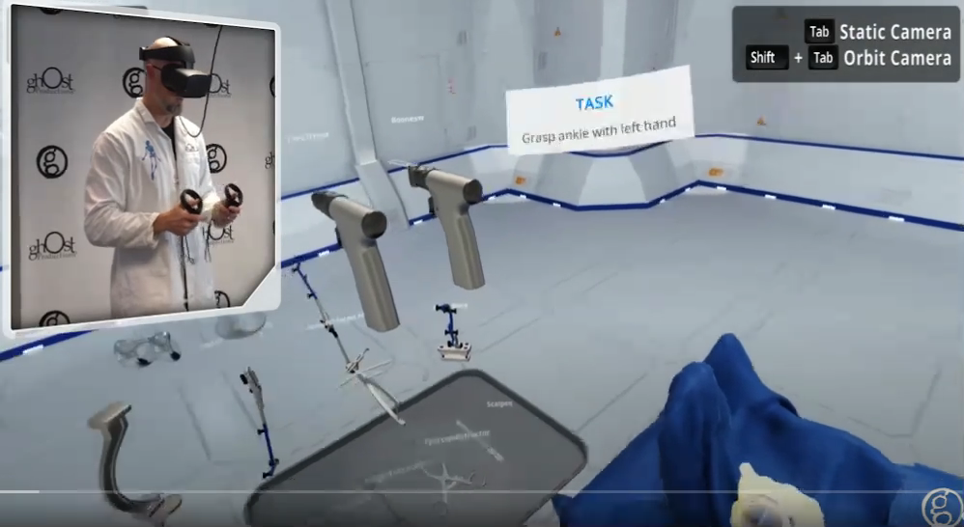
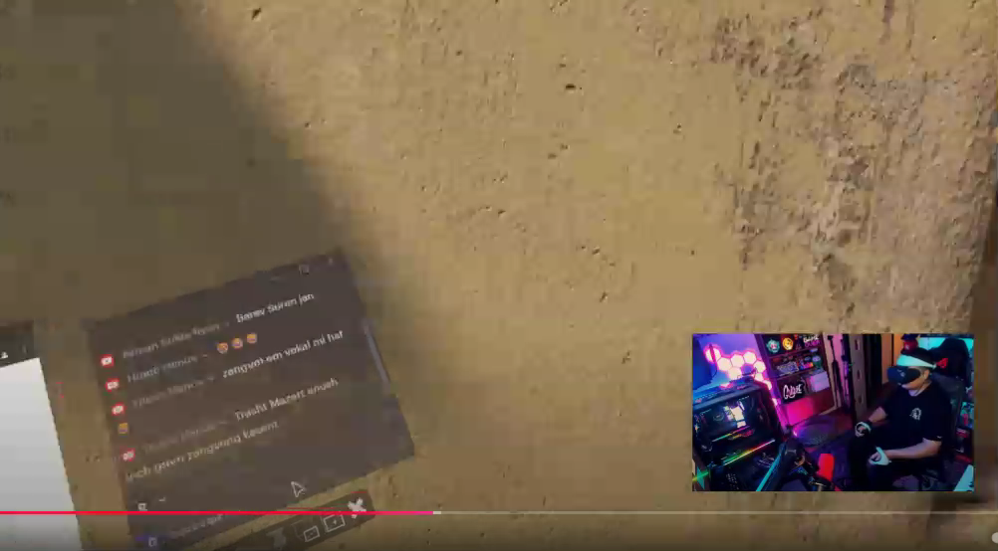
Examples
Games
APPS

Slide 17
Tracking systems are essential for translating physical actions into virtual interactions, making VR feel more intuitive and immersive. The technology behind these systems is what makes VR truly interactive, allowing users to manipulate and explore the virtual world using their movements.
.
VR Tracking Systems

Slide 18
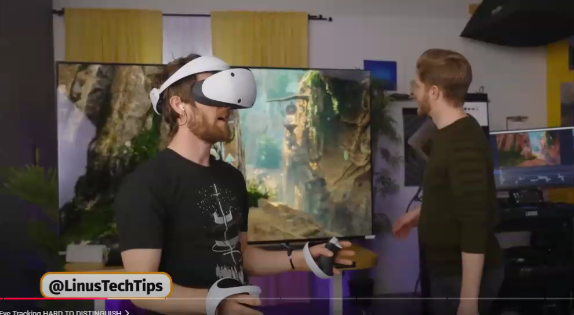
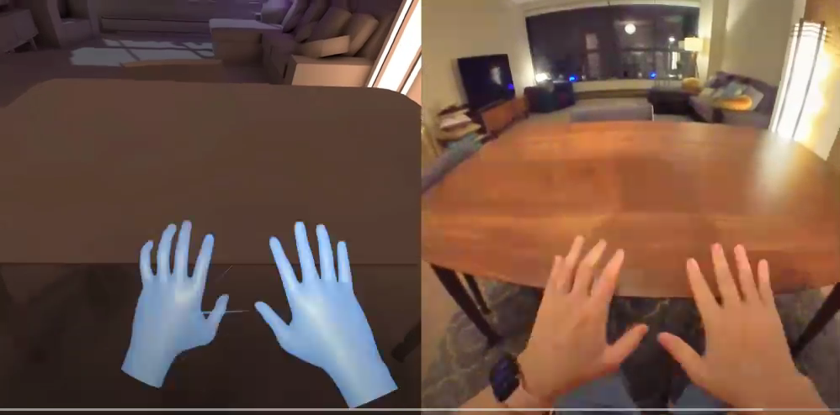
Examples
Eye tracking
Hand tracking

Slide 19
Operating systems in VR are specifically designed to optimize the hardware's performance , ensuring that VR applications run smoothly and are responsive. These OS platforms provide the interface and functionality needed to interact with the VR hardware and software.
VR Operating Systems

Slide 20
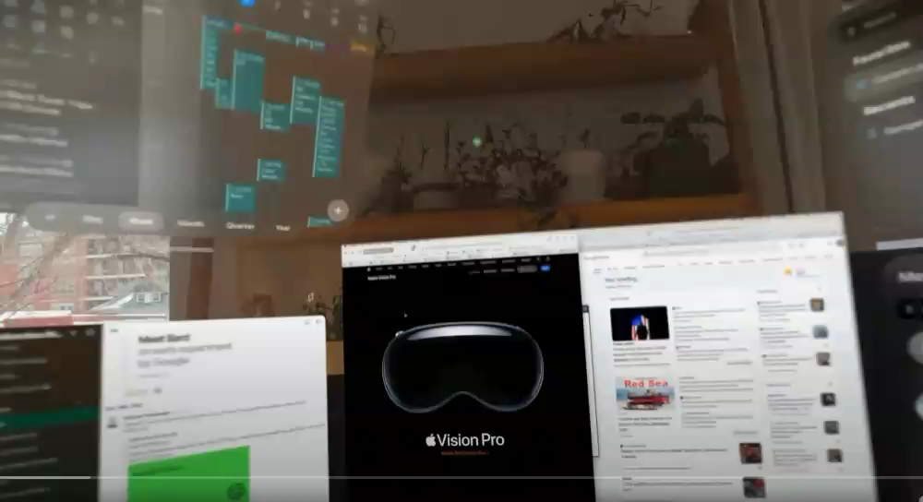
Examples of VR operating systems
Apple Vision Pro

Slide 21

APPLICATION OF VIRTUAL REALITY
04

Slide 22
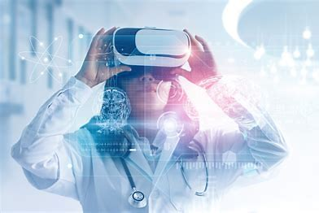
VR in Healthcare

Slide 23
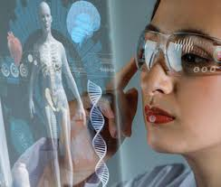
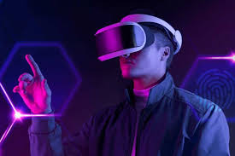
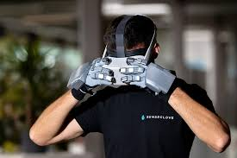
VR Devices in Healthcare
Head-Mounted Displays
Haptic Gloves
Smart Glasses
These gloves enable natural interaction with virtual environments, enhancing surgical simulations.
Smart glasses, such as Google Glass, assist doctors during surgeries.
Devices like Oculus Rift and HTC Vive provide immersive VR experiences.

Slide 24
Evolution of VR in Healthcare
1
1950s
The concept of VR emerged, but technology was not advanced enough for practical applications.
2
1990s
VR technology became more accessible, leading to initial applications in medical training and pain management.
3
2010s
VR gained traction in pain management, exposure therapy for phobias, and cognitive rehabilitation for stroke patients.
4
2020s
The COVID-19 pandemic accelerated the adoption of telehealth and remote patient care using VR platforms.

Slide 25
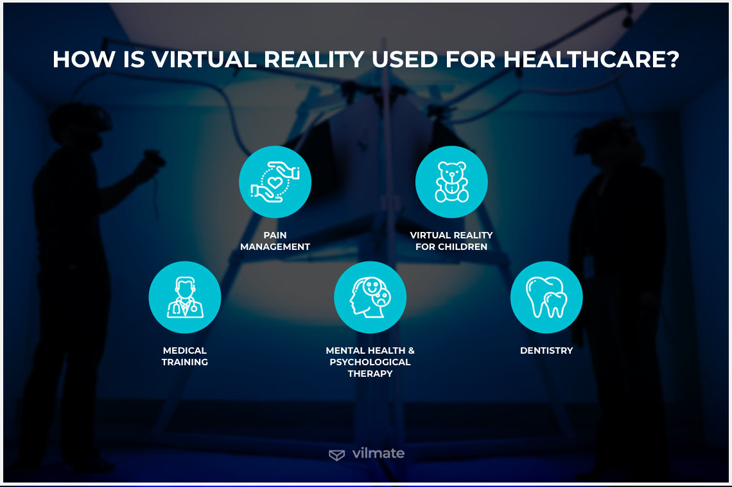

Slide 26
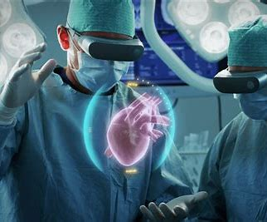
Medical Training with VR
1
Hands-On Learning
VR training allows medical professionals to practice procedures in a safe and controlled environment
2
Rare Case Scenarios
VR simulations can include even very rare clinical cases, providing valuable experience.
Johnson & Johnson Institute
Launched a global VR training program for surgeons, nurses, and medical students.
3

Slide 27

VR for Pain Management
Distraction Technique
VR provides an immersive and engaging experience, diverting attention from pain.
Reduced Medication Use
VR can help reduce the need for pain medication, leading to fewer side effects.
AppliedVR
Uses VR as part of its pain management program, reporting significant pain reduction.

Slide 28
VR in Mental Health
PTSD Treatment
Anxiety Disorders
Exposure Therapy
VR exposure therapy is effective for treating PTSD symptoms, such as flashbacks and nightmares
VR can help reduce panic attacks and other anxiety symptoms by providing a safe space to practice coping mechanisms.
VR helps patients confront their fears and anxieties in a safe and controlled environment

Slide 29
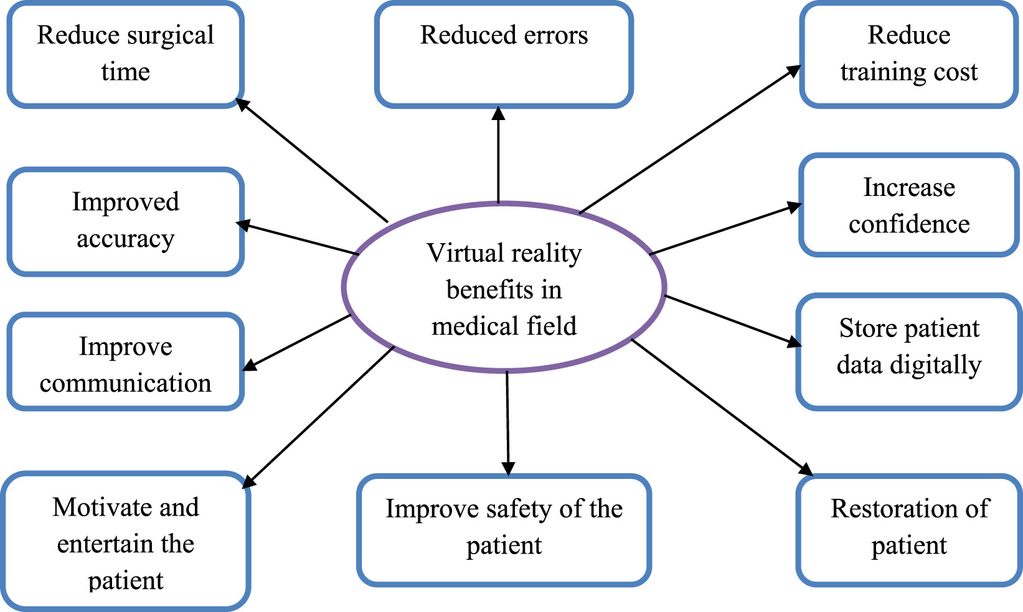
Benefits of VR

Slide 30

VR IN EDUCATION VR revolutionizes education by offering immersive , interactive learning.It enables students to explore,practice, and graps abstract concepts in simulated environments , enhancing skill-based training and experiential learning while boosting engagements
.

Slide 31

Application VR in education
Engineering &Science :
VR visualizes complex topics and industrial processes with immersive simulations.

Slide 32
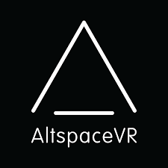
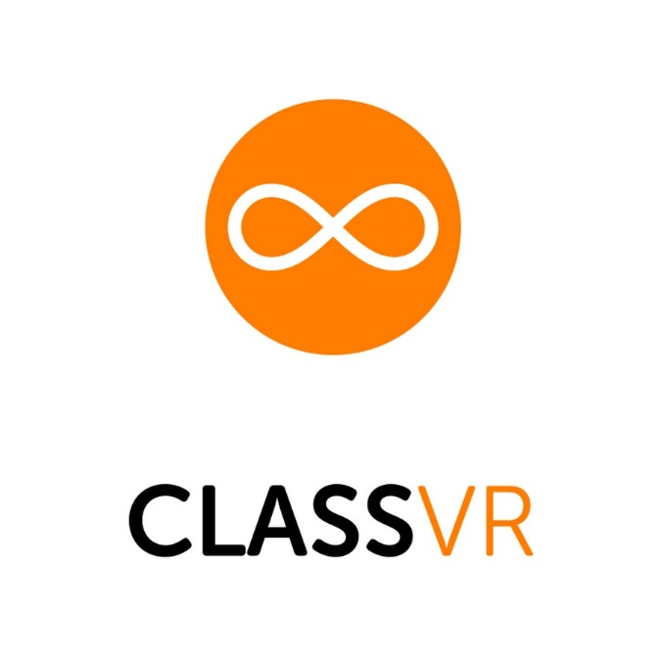

Application VR in education
Collaboration:
VR enables interactive ,real-time global learning through virtual classrooms.

Slide 33
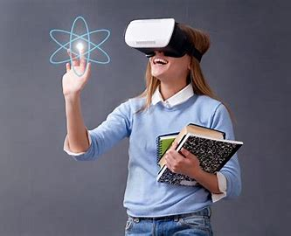
Application VR in education
Specialized Education:
Tailored VR environments support learning for students with disabilities

Slide 34

Application VR in education
Nefertari VR: Journey to Eternity
Language & History:
Immersive environments for language learning and virtual field trips to historical sites.

Slide 35

Application VR in education
Skill Training
VR provides realistic simulations for safe , risk free practice in various fields.

Slide 36
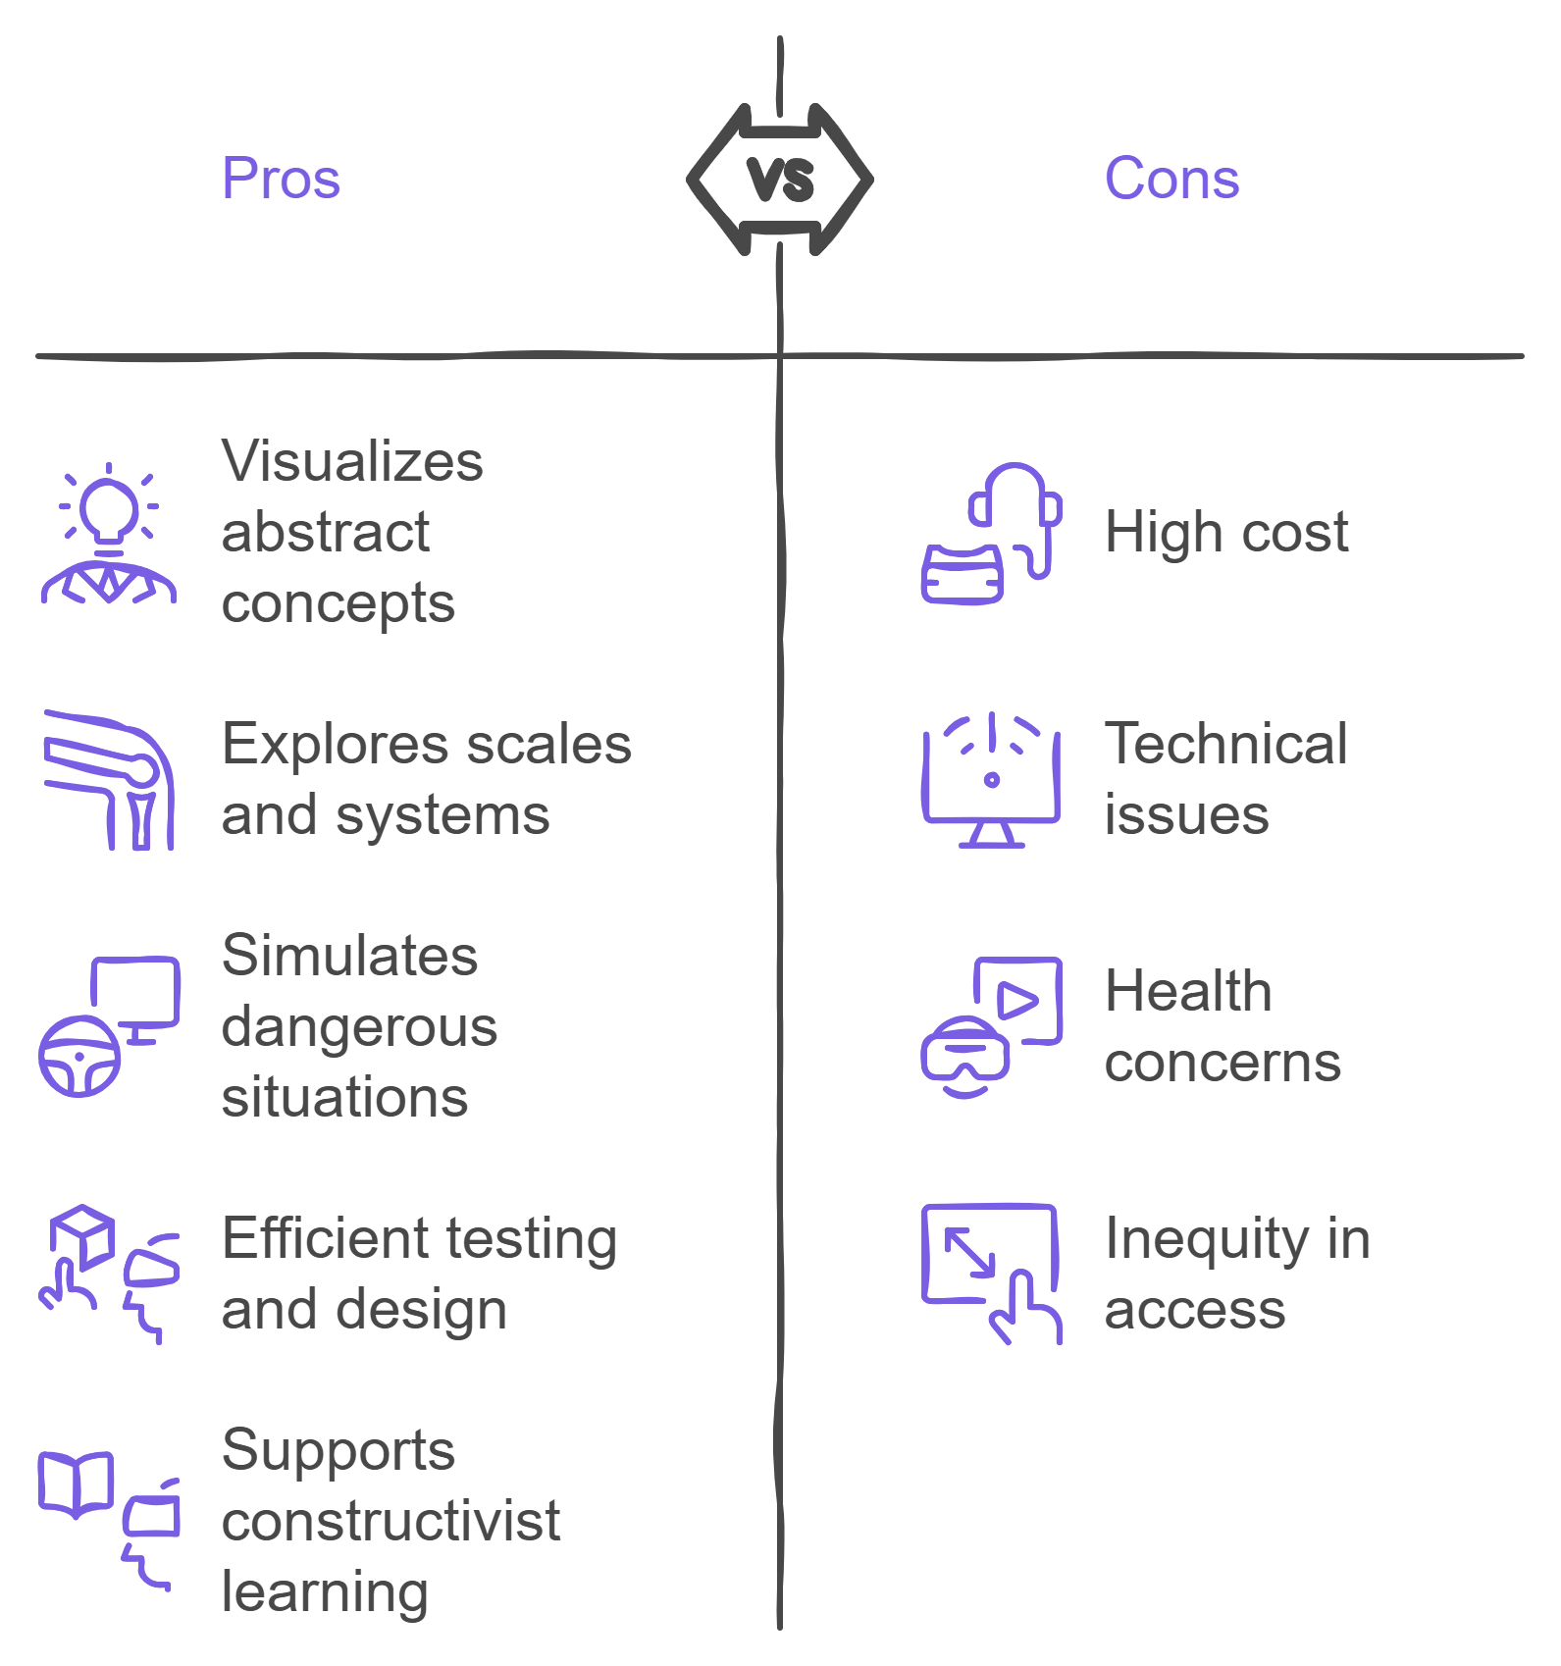
Advantages & Problems

Slide 37
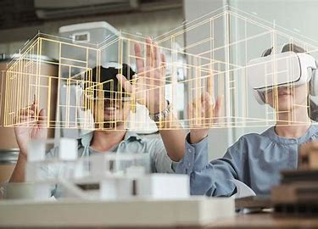
VR IN ARCHITECTURE Virtual Reality (VR) has emerged as a powerful tool in the field of architecture, significantly enhancing the way architects design, visualize, and communicate their ideas. By creating immersive 3D environments, VR allows architects and clients to interact with designs, improving communication, reducing mistakes, and boosting creativity. Architects can realistically showcase their ideas, enabling clients to experience
.

Slide 38

VR’S EVOLUTION IN ARCHITECTURE
1
1960s-1980s
Early head-mounted displays and Computer-Aided Design (CAD) laid the foundation for VR in architecture.
2
1990s
VR technology gained traction with the development of 3D rendering tools and simulators, making it a valuable tool for architects.
3
2000s-Present
Integration of VR with Building Information Modeling (BIM) has created highly immersive architectural experiences.

Slide 39

Key Uses of VR in Architecture
Better Visualization
Engaging Clients
Architects can create realistic 3D models to explore designs and test lighting effects.
Clients can understand designs through virtual tours and provide more useful feedback.
Collaboration in Real-Time
Team members can work together in virtual spaces, speeding up decision-making.

Slide 40


Real world examples
The Edge Tower (Amsterdam)
San Francisco Museum of Art
VR was used to visualize and test the design of spaces before construction began.
VR was used to test the layout of new exhibits before renovation work began.

Slide 41

05
Advantages And Challenges

Slide 42
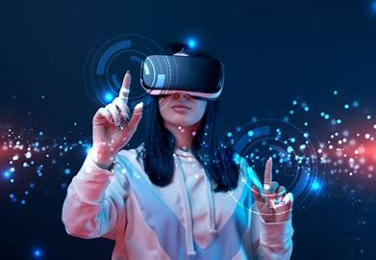
Advantages of Virtual Reality (VR)
Virtual Reality (VR) has evolved into a transformative technology with applications across multiple industries. It offers immersive and interactive experiences that enable users to engage with digital environments in a way previously impossible. Below, we explore the many advantages of VR in various fields.

Slide 43
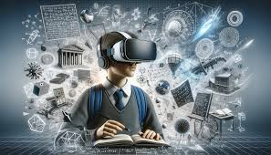
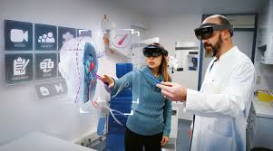
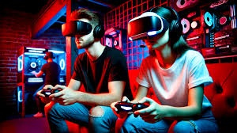
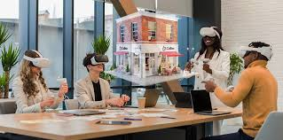
Education and Training:
VR provides immersive and interactive environments for learning and skill-building.
It allows safe and cost-effective simulations for students, pilots, surgeons, and emergency responders.
1
Healthcare:
VR helps in therapy, rehabilitation, and pain management.
It enhances medical training with surgical practice and anatomy visualization.
2
3
Entertainment:
Revolutionizes gaming with immersive gameplay and social connectivity.
Offers interactive storytelling in movies and virtual participation in live events like concerts.
4
Business and Industry:
Improves design and prototyping in engineering and architecture.
Enables virtual shopping, remote collaboration, and global training workshops.

Slide 44
VR Advantages
Virtual Reality is a versatile technology that provides significant advantages across education, healthcare, entertainment, business, and beyond. Its ability to simulate, immerse, and engage transforms how we learn, work, and interact with the world. As the technology continues to advance, VR is poised to become an integral part of our daily lives, unlocking new possibilities and reshaping industries.

Slide 45
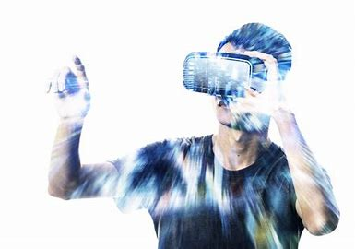
VR CHALLENGES

Slide 46


Virtual reality has transformative potential but faces challenges such as technical
limitations, high costs, content gaps, and user experience issues. Overcoming these barriers is key to its success. Here we will discuss some of these challenges.
VR CHALLENGES
Technical:
Bulky headsets, high hardware demands.
Software complexity (motion sickness, tracking issues).
Content:
The limited availability of high-quality VR content, combined with the lack of standardization across platforms, creates barriers to delivering consistent and engaging experiences while also complicating compatibility between different systems.

Slide 47
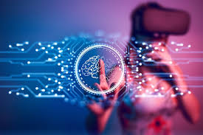
Social/Psychological:
Social Isolation: Too much time spent in VR can reduce real-life interactions, creating feelings of loneliness
Psychological effects: Excessive use can cause addiction, stress or emotional disturbances.
Economic:
High hardware costs, such as headsets and powerful computing devices
User Experience:
Accessibility issues and lack of personalization in VR limit user engagement and hinder fully immersive, inclusive experiences.
VR CHALLENGES

Slide 48
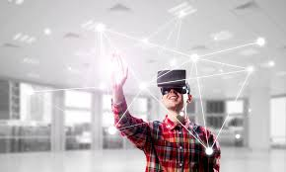
VR CHALLENGES
Market:
The VR market faces fragmentation with numerous competing platforms and standards, making it difficult for consumers to adopt. Additionally, rapid technological advancements lead to quick product obsolescence, discouraging long-term investment.
These challenges must be addressed to ensure VR reaches its full potential and becomes accessible to a wider audience.

Slide 49
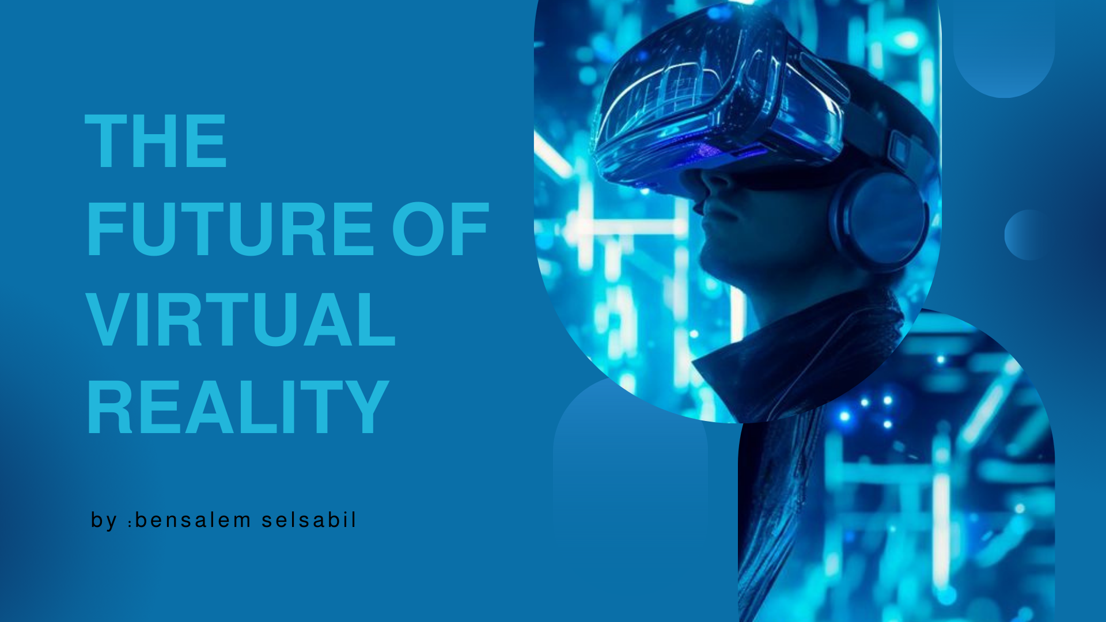

Slide 50
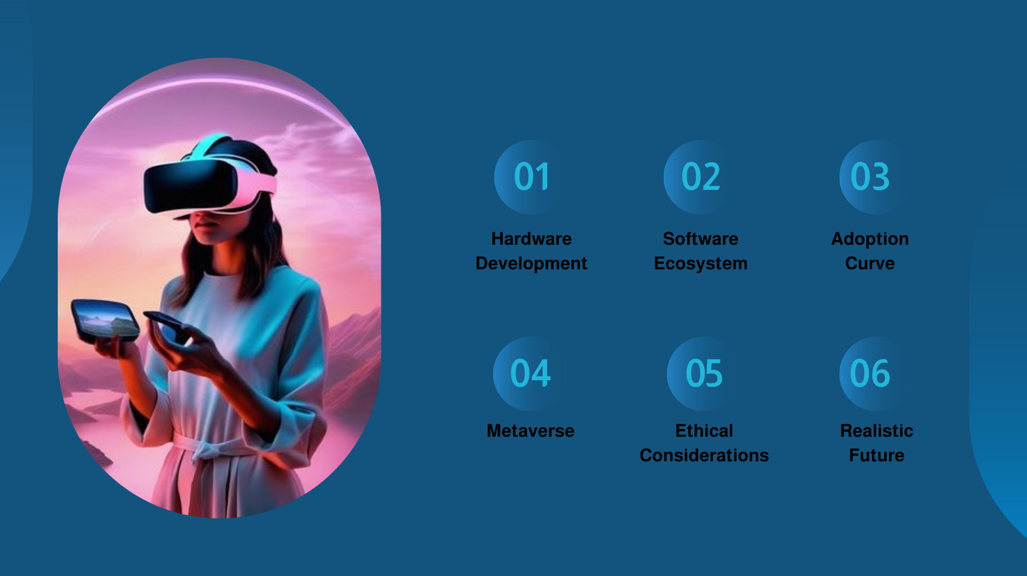

Slide 51
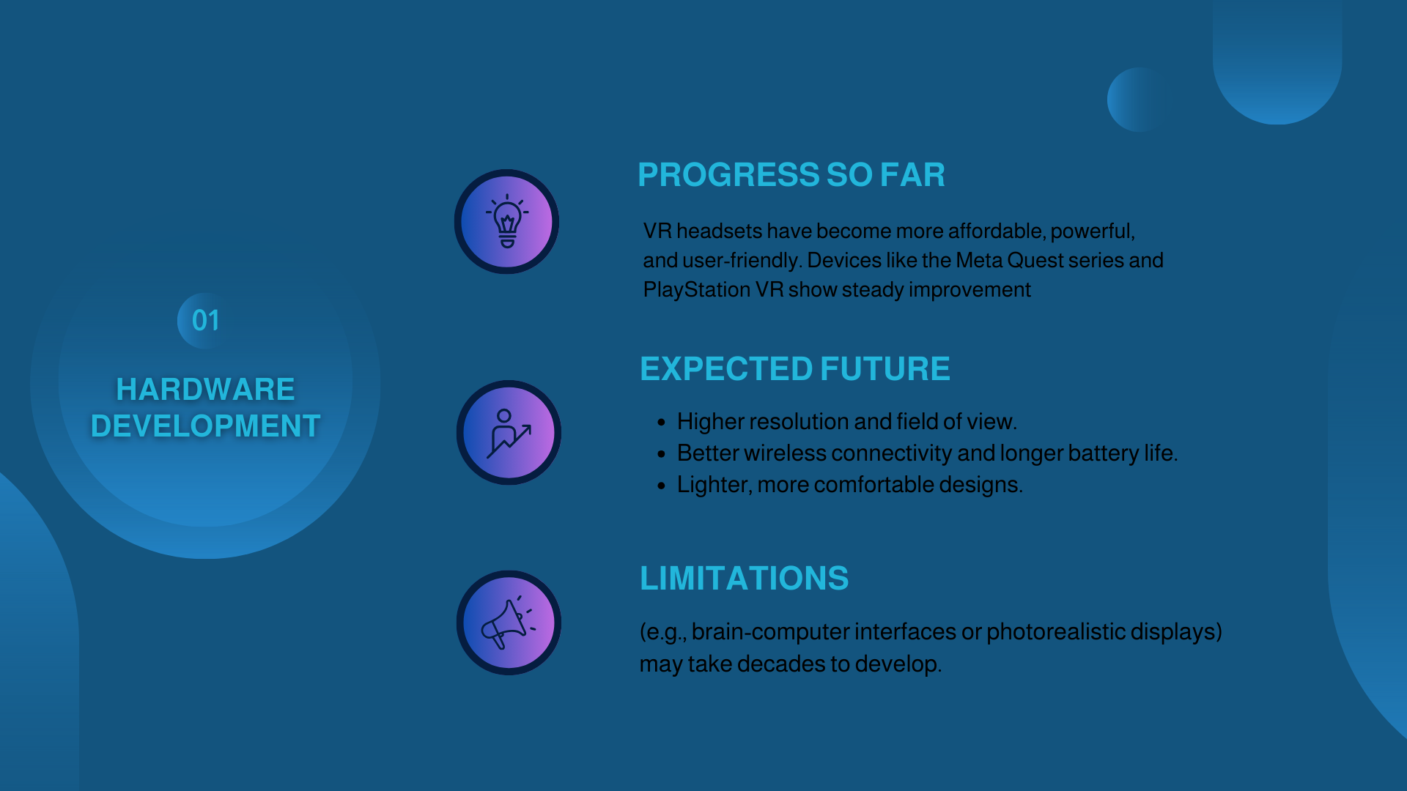

Slide 52


Slide 53
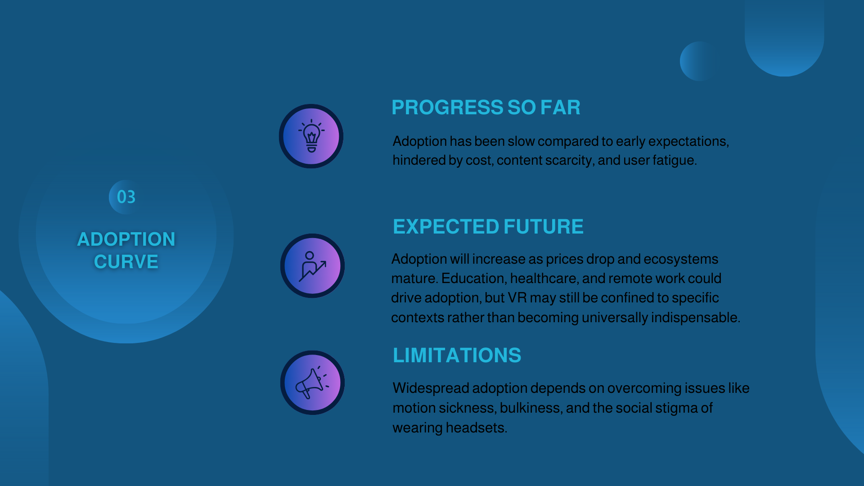

Slide 54


Slide 55
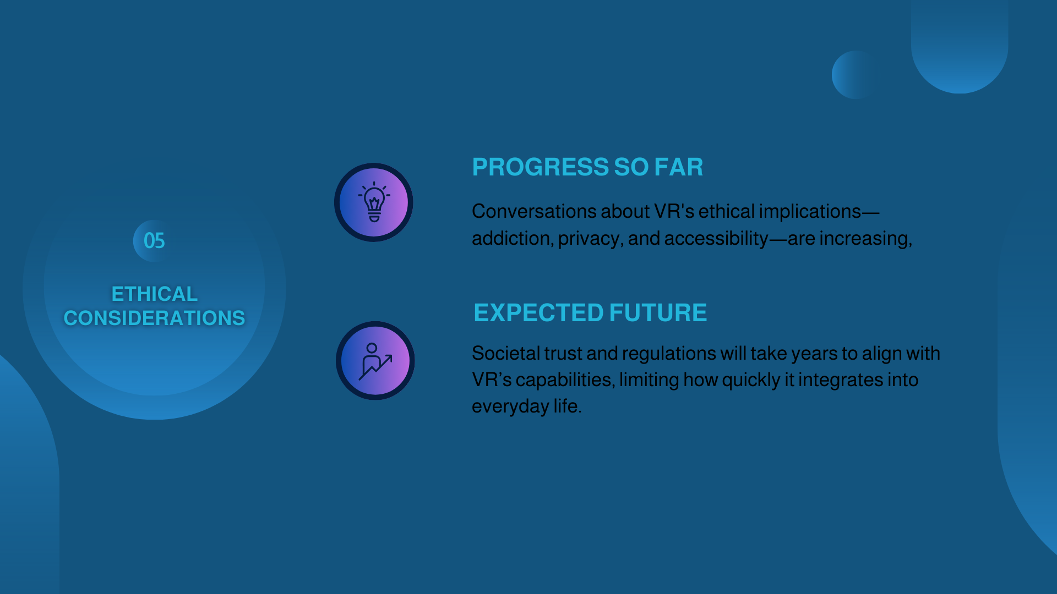

Slide 56
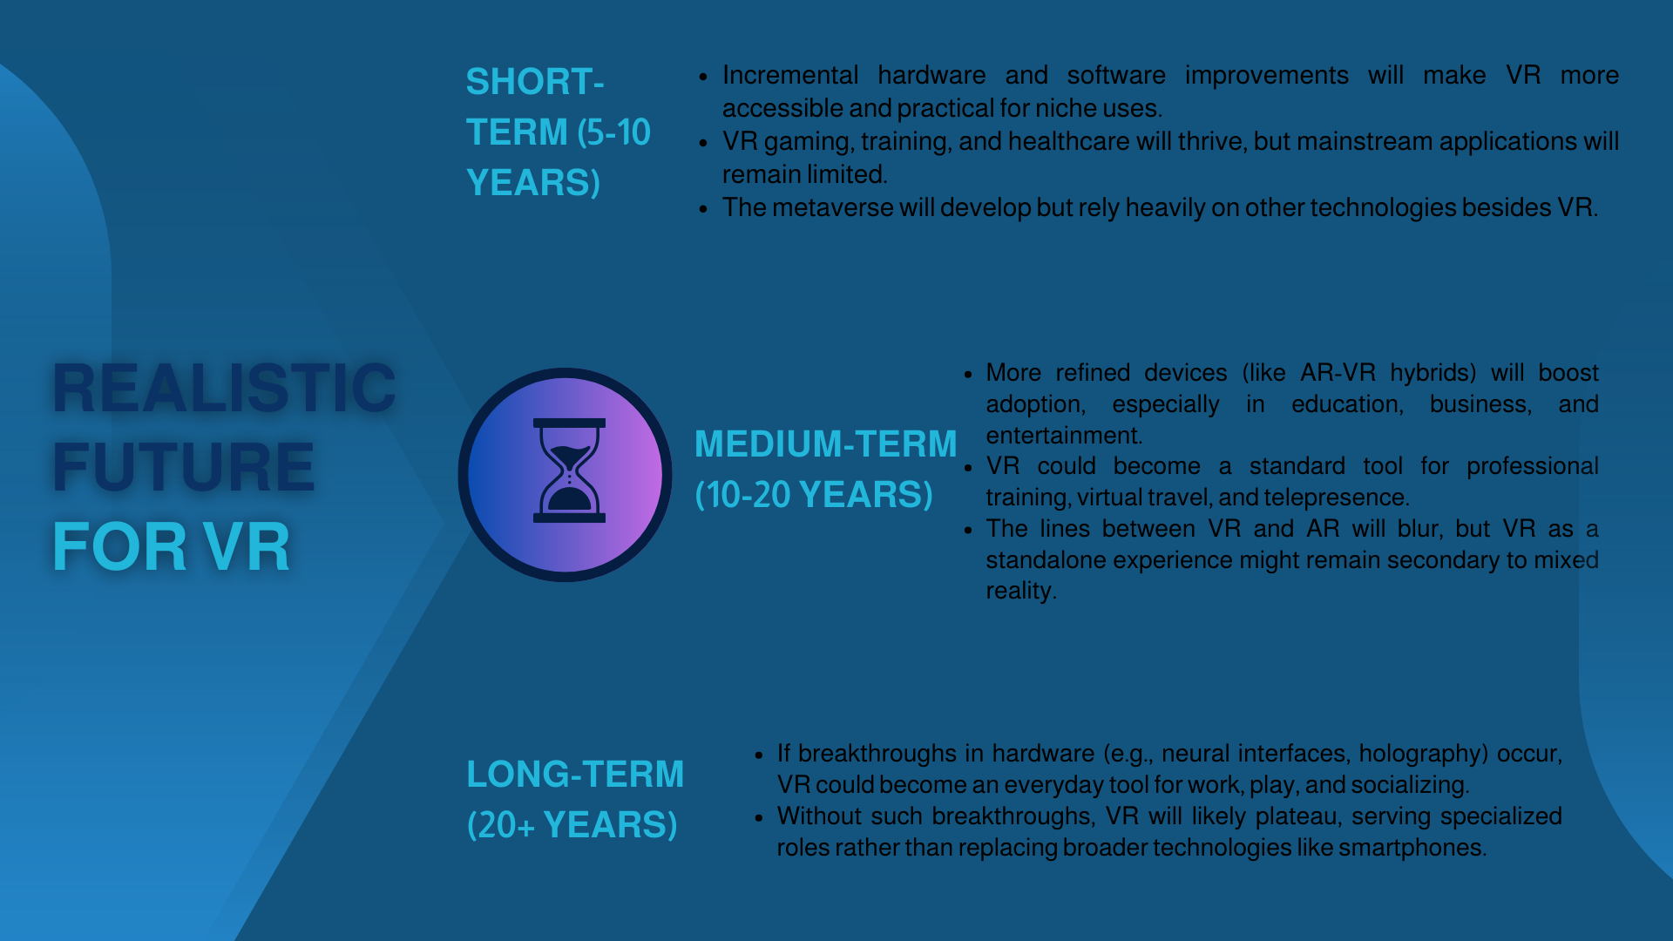

Slide 57
Thank you for listening

